Slide 1




Princess Nora bint Abdulrahman University
College of Computer and Information Sciences
COOP final presentation
Ghadah Alharbi
438001976
King Fahd Medical City (KFMC)

Slide 2
Outline: Department structure Role and responsibility Accomplished tasks Problems and difficulties Implemented solutions Skills and learnt techniques

Slide 3
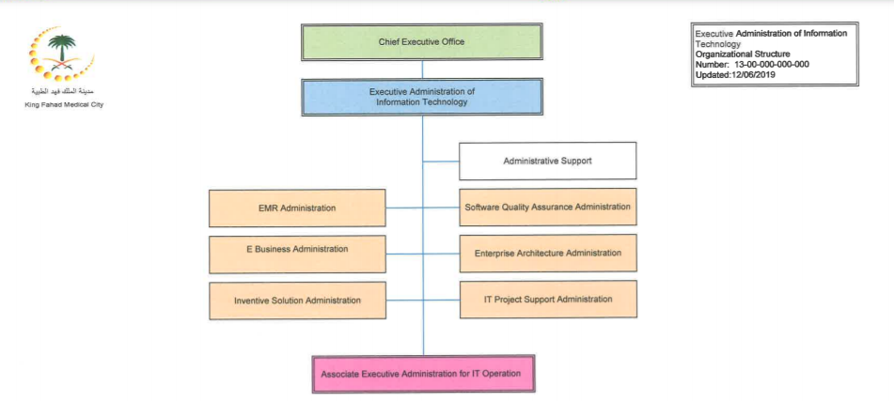
Department structure
my training program was in Executive Administration of information technology

Slide 4
Role and responsibility
I have worked as a trainee student in Executive Administration of information technology
under the supervision of Dr. Ali AL Hussein, I had the responsibility of attending every weekly
meeting and perform all the tasks discussed in it on time.
I also had the responsibility of representing PNU well and follow the professional ethics.

Slide 5
Accomplished tasks
The final project in ASP.NET Web Forms
This final project objective was to create a web site that has the following features.
Apply CRUD operation, Develop Registration Input Form and Grid View, Develop Course Input Form and Grid View, Import Attendance Data from Excel to Database, Create Templates and automate printing report, Use Email Notification in a web, Apply site security.

Slide 6
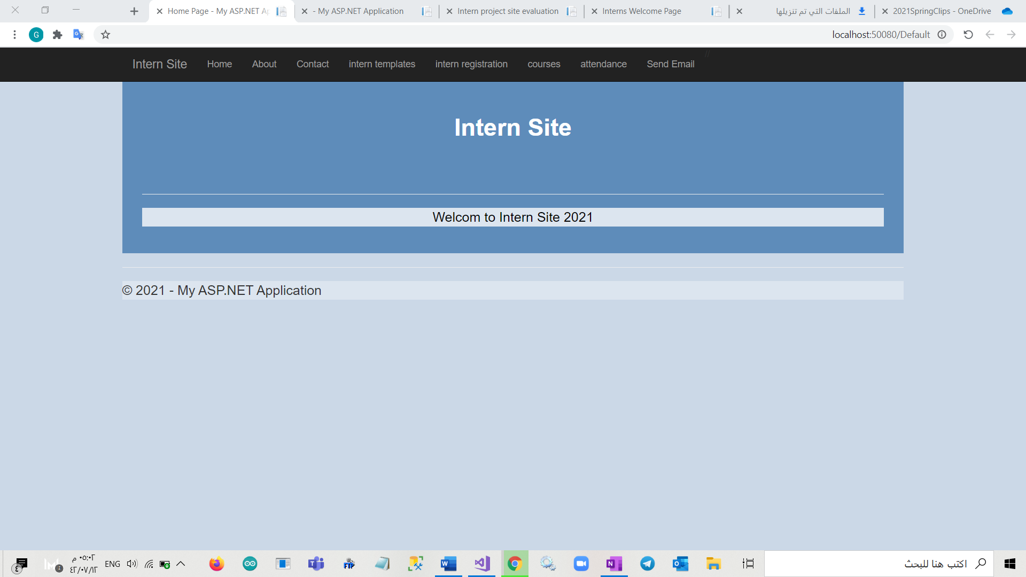
1.Intern welcome page

Slide 7
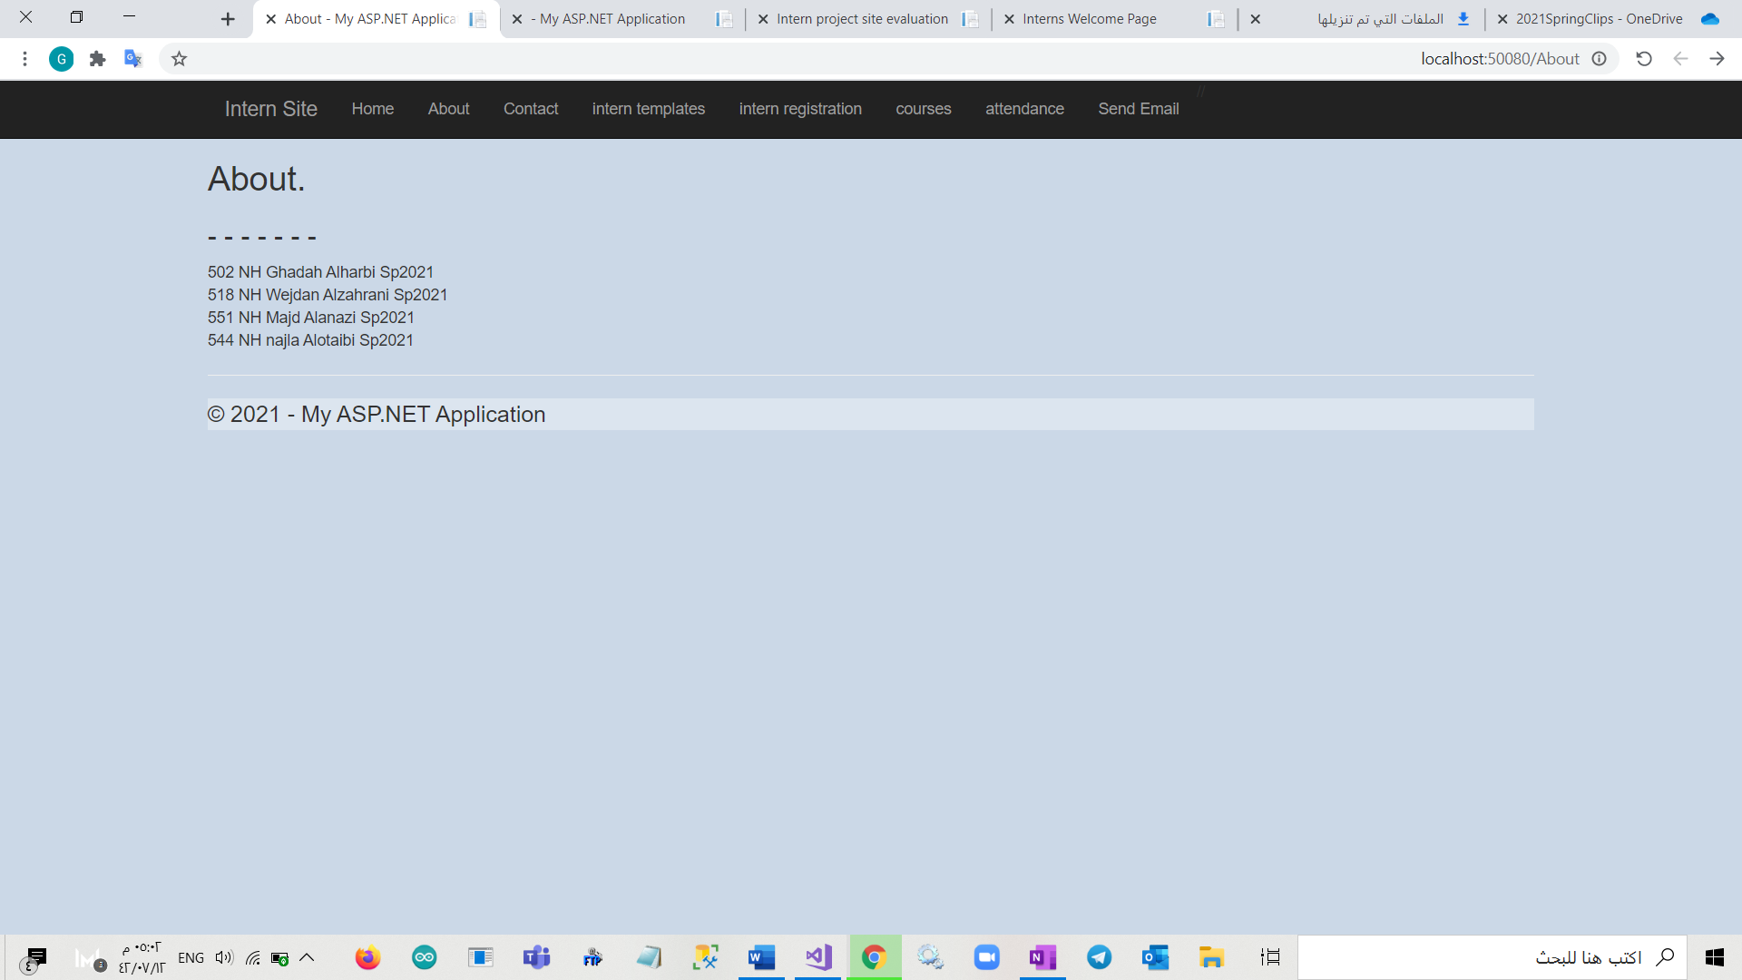
2.Contact page

Slide 8
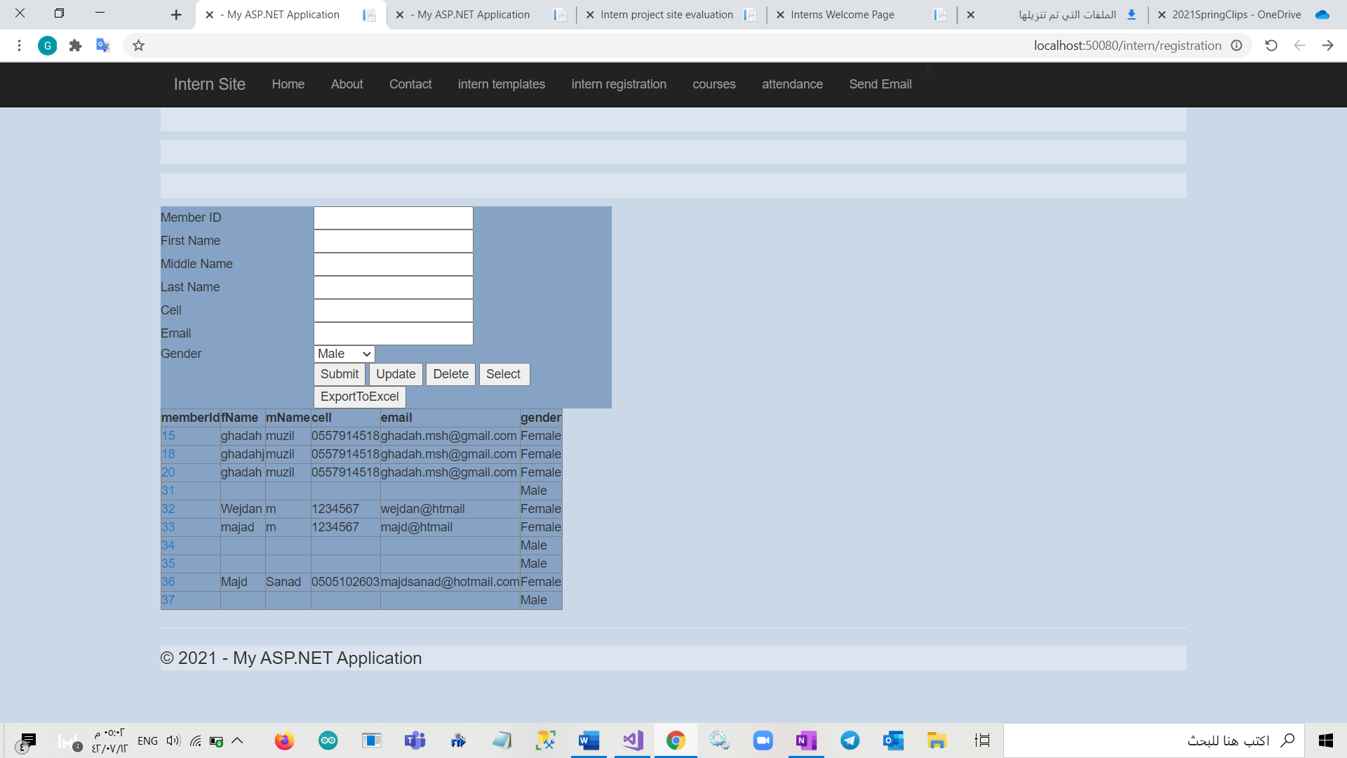
3.Intern registration page

Slide 9
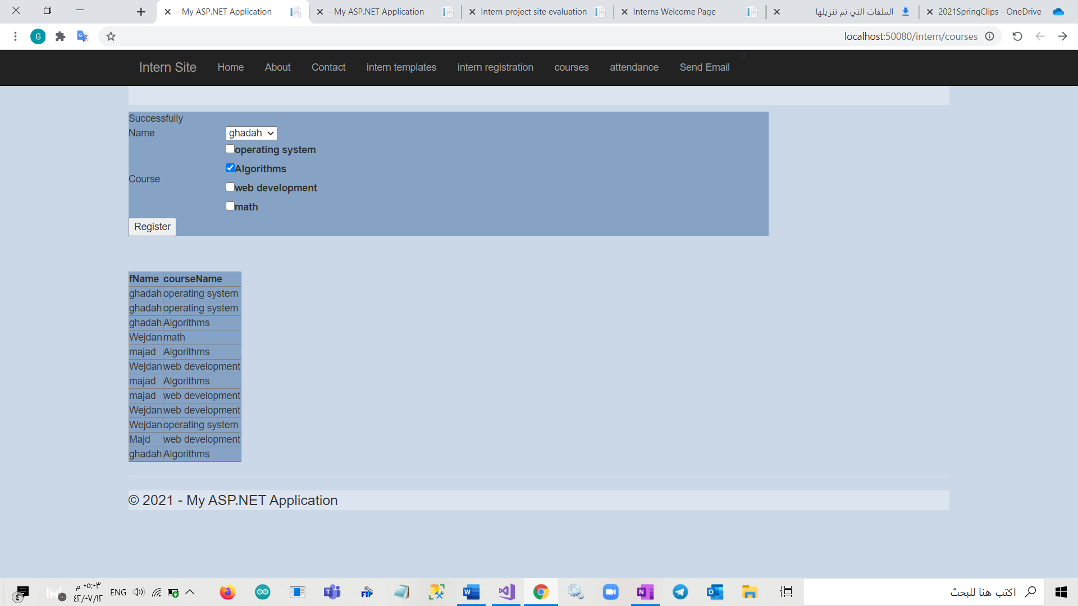
4.Courses page

Slide 10
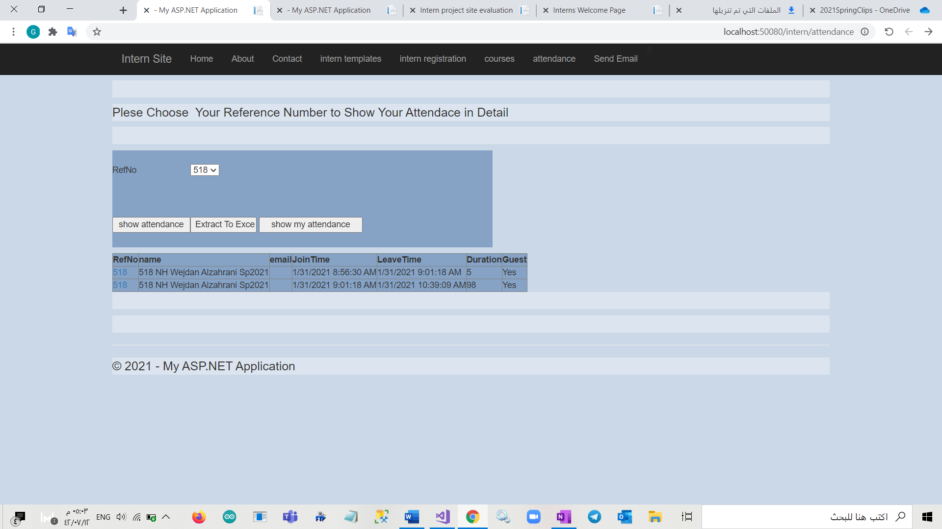
5.Intern attendance page

Slide 11
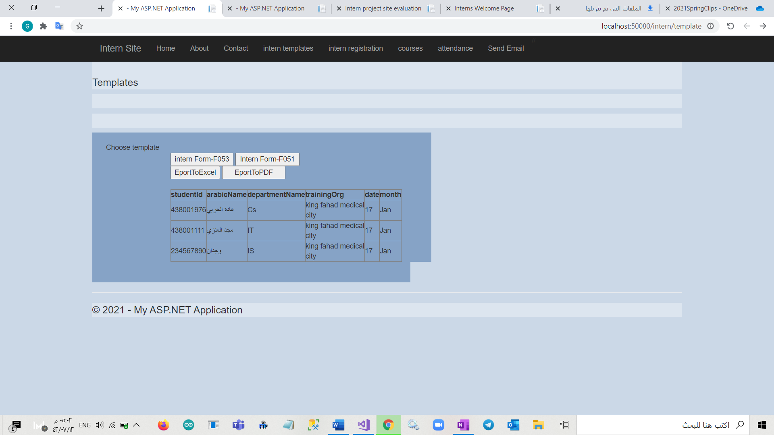
6.Intern templates page

Slide 12
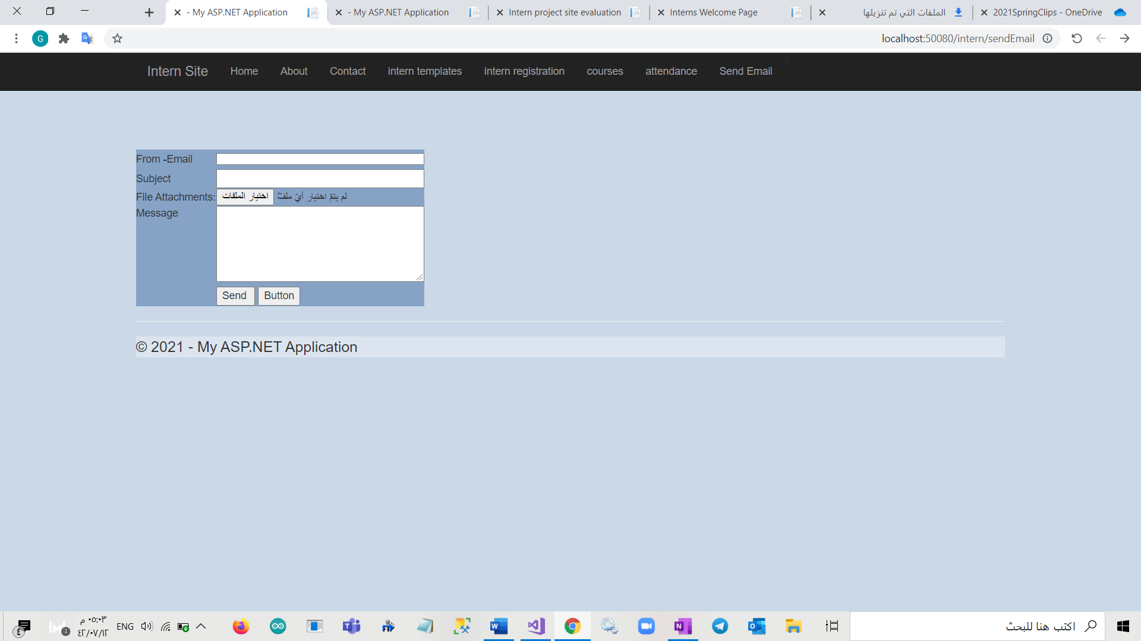
7.Sending Email page

Slide 13
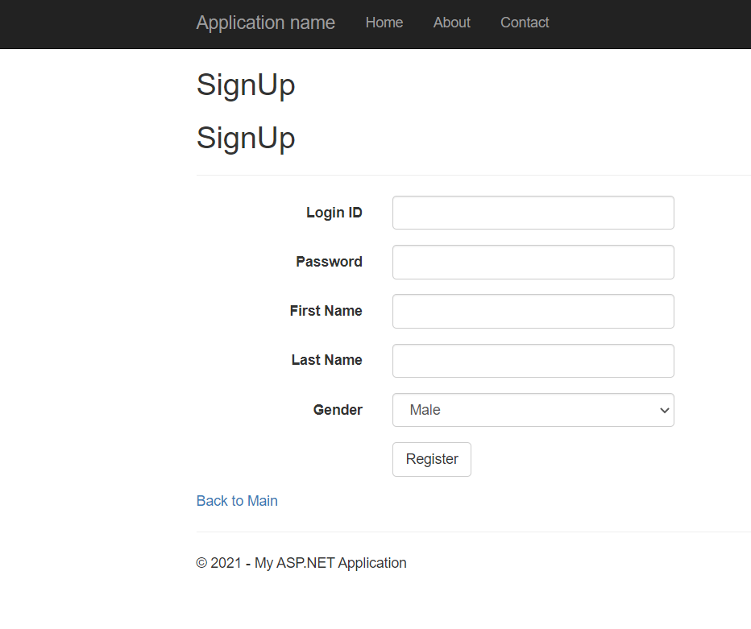
Accomplished tasks
Create Sign Up page in ASP.NET MVC
MVC is a design pattern used to decouple user-interface (view), data (model), and application logic (controller). This pattern helps to achieve separation of concerns.

Slide 14
Problems and difficulties
Telecommuting was the major difficulty during the training program if I have any questions or
need feedback about something. Also, some difficulties during resolve the assigned problems need direct explanation.

Slide 15
Implemented solutions
I have tried to search and learn on my own, to solve the issue, this was an advantage to me during each meeting. It helped me get more understanding when the supervisor explaining the issue. Also, I learned how to search and learn effectively.

Slide 16
Skills and learnt techniques
Build a web project.
Deal with different web-application framework, ASP.NET Web Forms and ASP.NET MVC.
Deal with SQL server management and CRUD operation.
Teamwork skill.
Self-learning skill
Time management skill

Slide 17
Thank you

